Slide 1

Welcome
Please feel free to play with the STEM activities on the table

Slide 2
Early Learning STEM Australia
2018 Pilot Educator workshops
ELSA is funded by the Australian Government Department of Education and Training through the National Innovation and Science Agenda

Slide 3
Welcome to the ELSA Pilot
Housekeeping
Notes:
Acknowledgement of Country – Museum to email
Welcome to pilot educators – states and locations
Introduction of ELSA team
Housekeeping
toilets
breaks
smoking
emergency procedures
Overview of two days – interactive sessions; learning with and from each other

Slide 4
Where are we now?
Write the five words that first come to mind when you hear the phrase STEM in early childhood on a post it note and stick it on the wall (no names)

Slide 5
Postcard matching

Slide 6
Observe your card
- what are you noticing?
Find your match - visual cues only
Notes:
Prompt discussion on features observed
What attribute did you notice? Size, colour, position, number
When you have your match – introduce and discuss card – features, questions, wonderings?

Slide 7
STEM practices
Observing
Curiosity
Questioning
Predicting
Notes:
Lead discussion on STEM practices in play during this activity

Slide 8
Why early years educators already embrace STEM

Slide 9
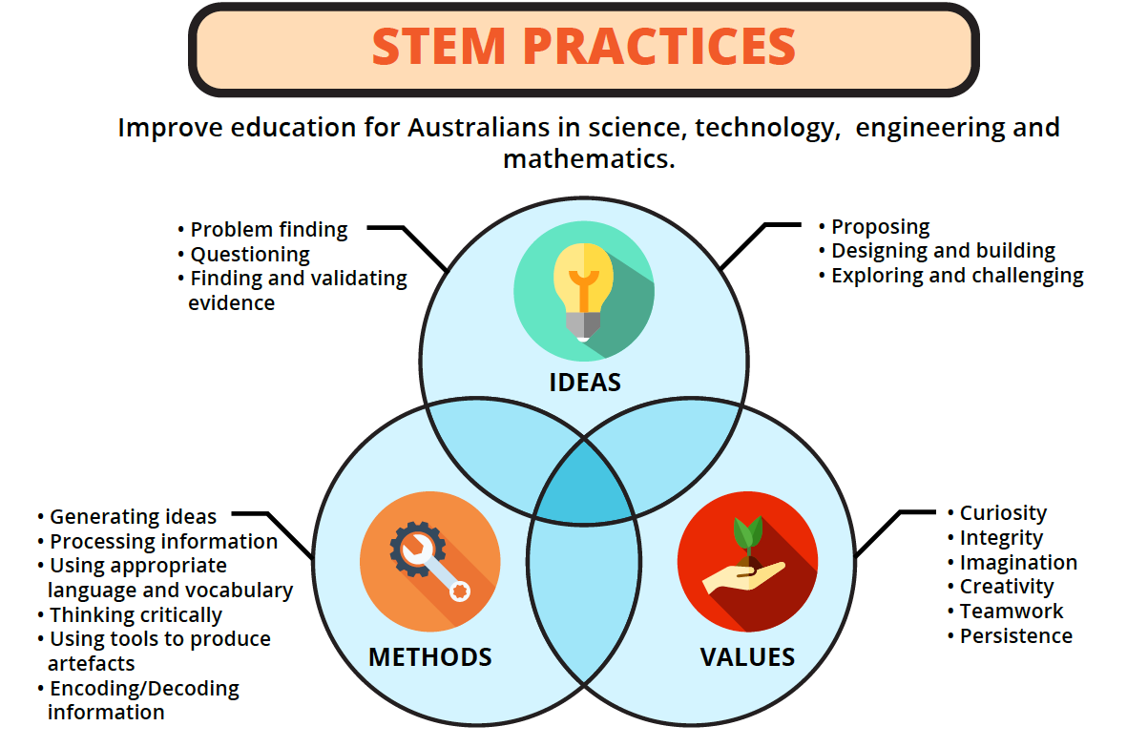

Slide 10
STEM practices in the early years
Before formal schooling
Play-based learning
Integrated engagement
Connected to world
During school & university
Directed learning
Content focused
Connected to testing
After formal schooling
Workplace learning
Integrated engagement
Connected to world

Slide 11
ELSA Practice Framework
STEM Practices: Ideas, Methods & Values (A way of thinking)
ERA Loop: Experience, Represent & Apply (A way of acting)
Communities of Practice: That ask and share the What, So What & What Next (A way of relating)

Slide 12
ERA Loop
EXPERIENCE
REPRESENT
APPLY

Slide 13
STEM in early childhood education

Slide 14

Science, Technology, Engineering and Mathematics

Slide 15
What is STEM?
Acronym that originated from the National Science Foundation (NSF) in the US
Some people regard STEM as any of the individual disciplines
We at ELSA think STEM practices underpin STEM

Slide 16
What is STEM?
I like to think of STEM as much more than an acronym. STEM really is a philosophy. STEM is a way of thinking about how educators at all levels—including parents—should be helping students integrate knowledge across disciplines, encouraging them to think in a more connected and holistic way. (Sneidman, 2013)

Slide 17
What is STEM?
STEM disciplines share a set of foundational processes and practices
Many of the central concepts, practices and dispositions of the disciplines build on and are connected to one another
But each is distinct, with discipline specific characteristics and knowledge

Slide 18
We already do STEM everyday
BUT we often don’t make it explicit
We need to let children know we are doing STEM

Slide 19
Making STEM explicit
It would be helpful if both teachers and parents paid equal attention to the naturally occurring mathematical experiences that children just as regularly encounter [as literacy] (Tudge & Doucet, 2004, p. 37)
I would argue the same for science and technology

Slide 20
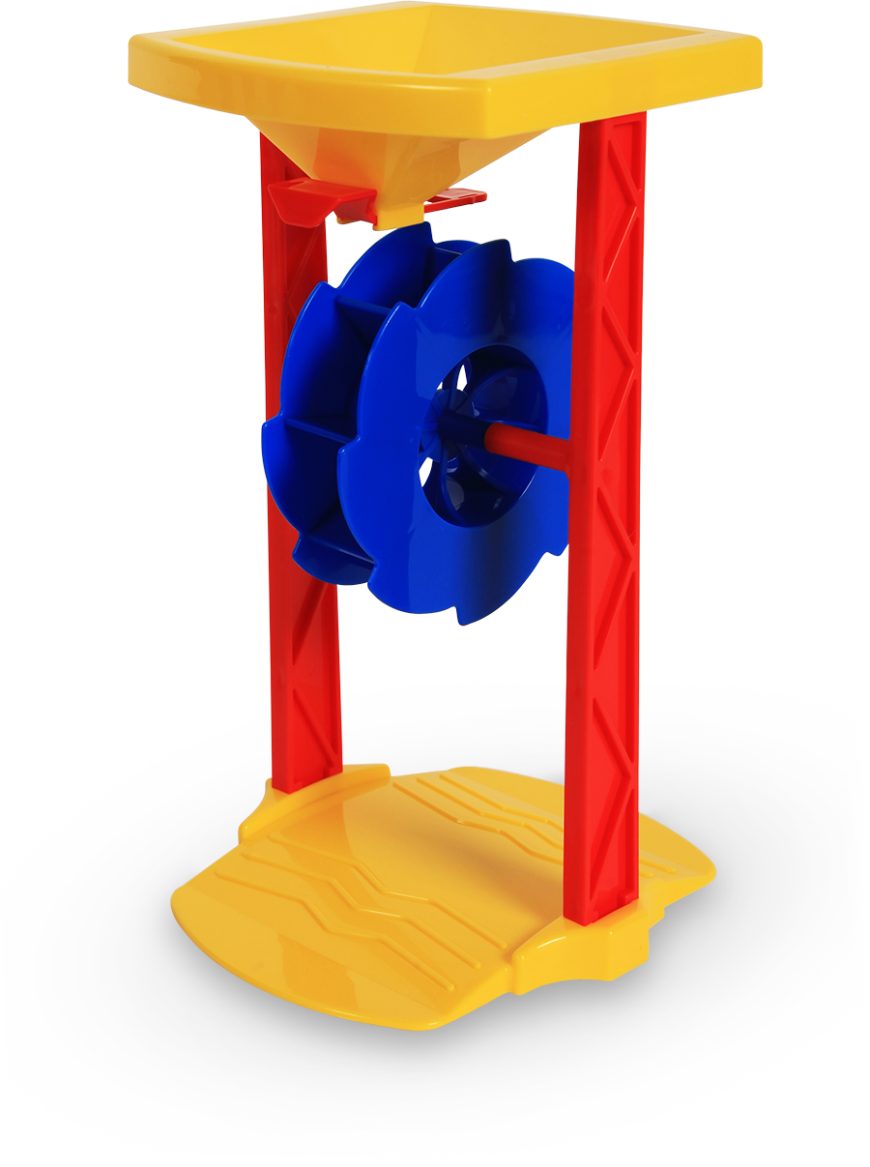

Making STEM more explicit
Children won’t consider the relationship between the amount of water/sand and how fast the wheel spins unless an adult stimulates this thinking.
We can ask, “How can we make the water/sand go slowly?”
Notes:
We need to notice the STEM opportunities and make them explicit.

Slide 21
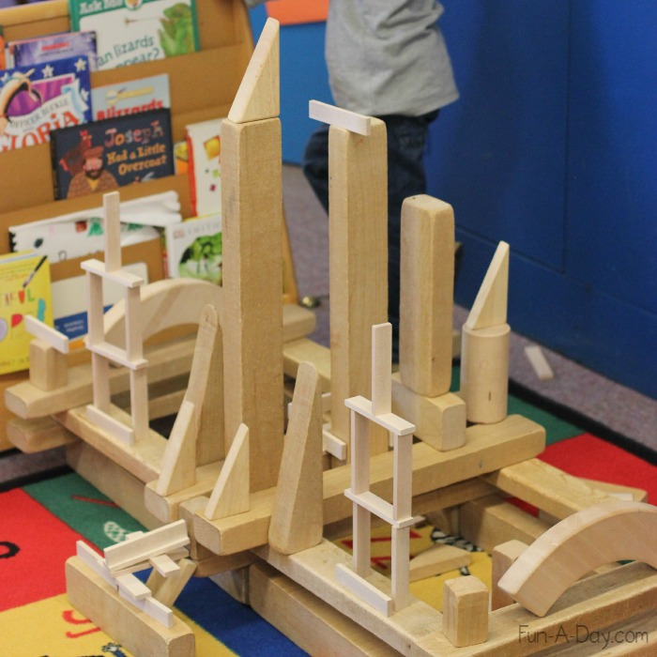

Making STEM more explicit
When children build block structures they need to know that this is also what engineers and architects do
http://fun-a-day.com/engineering-projects-for-kids-castles-in-the-block-center/
Notes:
Because engineering is studied at university level we often don’t connect children’s activities to real-life engineering jobs
When children build bridges we need to talk about how engineers have to solve problems to make bridges and roads. Properties of materials is also important in building and engineers and architects must consider materials they use

Slide 22
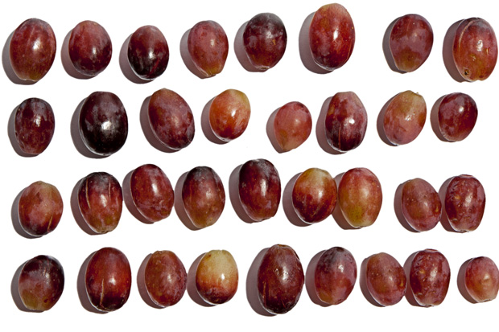
Making STEM explicit
When children argue over food rather than saying “I gave you both 5 grapes,” ask them how they could figure out if they have the same amount.
https://www.chowhound.com/food-news/80652/how-many-fruits-and-vegetables-should-i-eat-a-visual-guide/

Slide 23
Why is STEM so important
It is likely that 75 per cent of future jobs will require mathematics, analytical thinking, reasoning and problem-solving skills (Australian Industry Group, 2013).

Slide 24
Now we have recapped what STEM is and why it’s important – Why STEM in the early years?

Slide 25
Why focus on STEM in the early years
Early investments in STEM pay off
Children’s attitudes about STEM and about themselves as STEM learners are formed early

Slide 26
Early STEM matters
Early numeracy achievement in Foundation is a better predictor of later school success than early literacy ability and social-emotional skills (Duncan et al., 2007)

Slide 27
Closing the gap
Children from different SES backgrounds enter Foundation with large differences in STEM experiences and understandings and these differences tend to persist and grow over time
Early STEM experiences can help lessen these gaps

Slide 28

Why STEM in early childhood
Just like language and literacy, STEM education should start early in order to maximise its benefits and effectiveness.
http://www1.nyc.gov/site/talktoyourbaby/index.page New York City - Talk to your baby.

Slide 29

Beliefs about STEM
Adult’s beliefs about STEM affect children’s beliefs about STEM

Slide 30
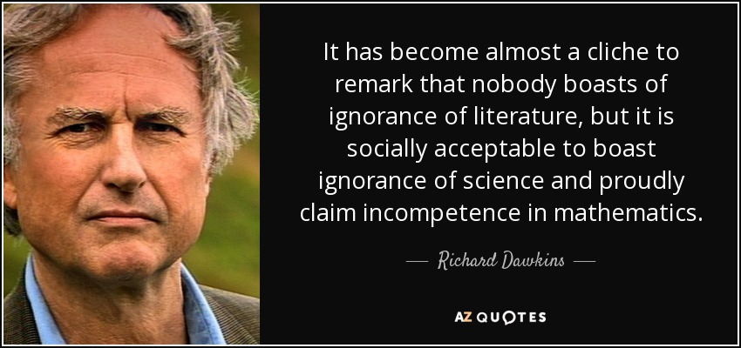
Social norms about science and maths compared to literacy
University of Oxford's Professor for Public Understanding of Science 1995 - 2008
Notes:
Who boasts about not being able to read

Slide 31
STEM as important as literacy
The movement to get parents and educators to develop children’s literacy skills before school has been very successful
We need the same for STEM

Slide 32
Children as capable STEM learners
Young children are powerful thinkers
We often underestimate what young children can do
In some ways developmental theories have limited our vision of what children are capable of doing and understanding

Slide 33
Spatial Reasoning

Slide 34
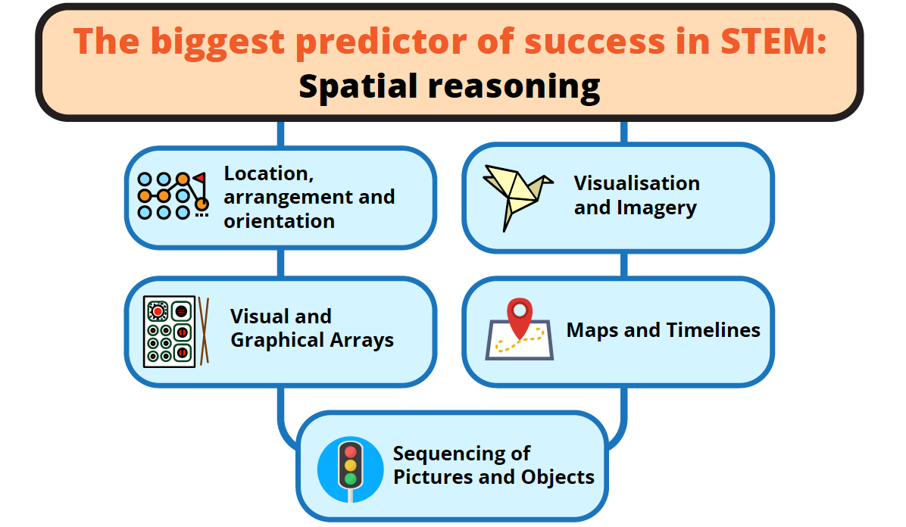

Slide 35
Spatial reasoning and ELSA
The central focus of Apps 1 and 2
Helps us understand and interpret our spatial world
Is critical beyond STEM
Improves rapidly through intentional teaching

Slide 36
STEM practices

Slide 37
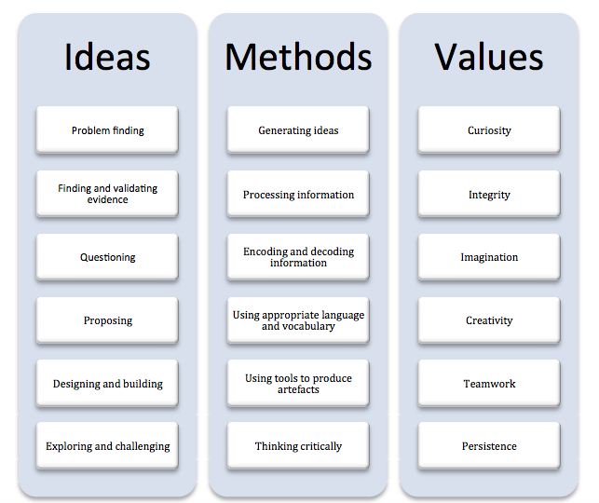
STEM Practices

Slide 38
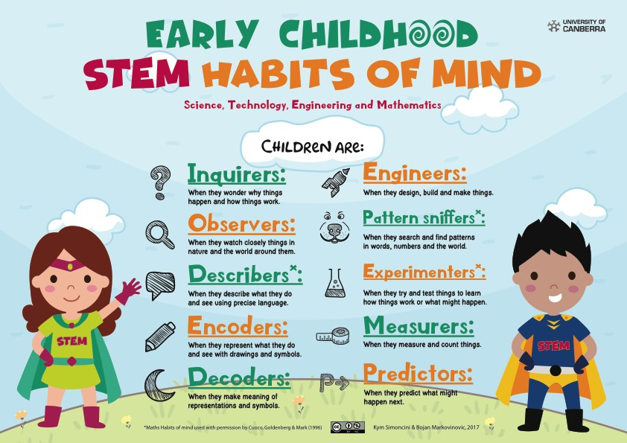

Slide 39
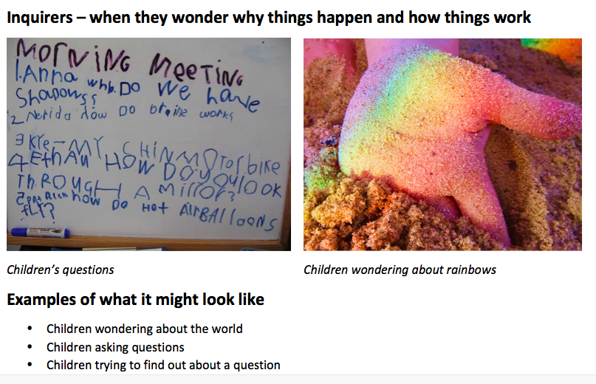

Slide 40
Your turn
Can you think of further examples of what habits of mind might
Look like (including photos we could use)
Sound like
How you could further the conversation

Slide 41

Asking good questions
The Boston Children’s Museum's STEM Sprouts Teaching Guide recommends asking “what” questions rather than “why” questions..

Slide 42

The problem with why questions
Implies there is a correct answer and the child is being tested
You may be just as unable to answer that question as the child is - Why is the magnet sticking to that kind of metal?

Slide 43
What questions
Start conversations
Focus on what is happening - what you are noticing, what you are doing— those answers are right in front of you and your kids.

Slide 44
What questions
Develop observation skills
Develop communication and language skills
Build confidence by giving them questions they can answer as experts

Slide 45
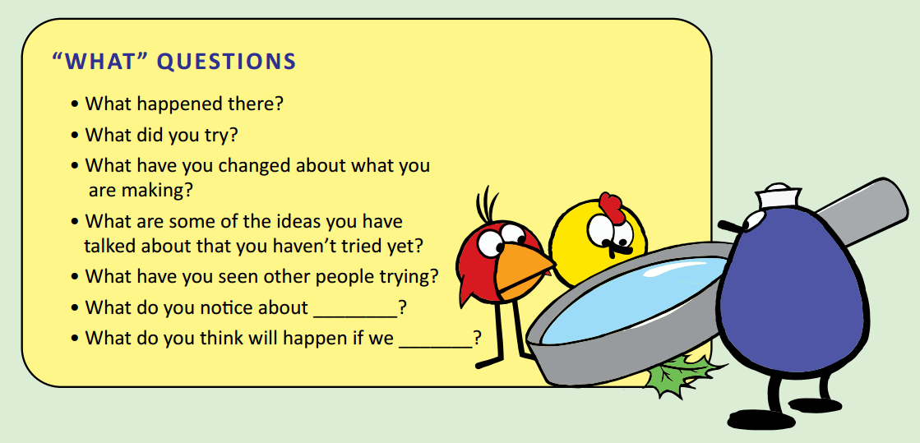
Examples of what questions

Slide 46
Your turn
What questions could you ask using the photos as stimuli
Choose a photo that resonates with you and write your questions on post-it notes

